Slide 1
FPROG Project
Florian Kretz, Adam Pikusa

Slide 2


Zum Projekt
IDE: Visual Studio Code
Language: Python

Slide 3
Demo

Slide 4
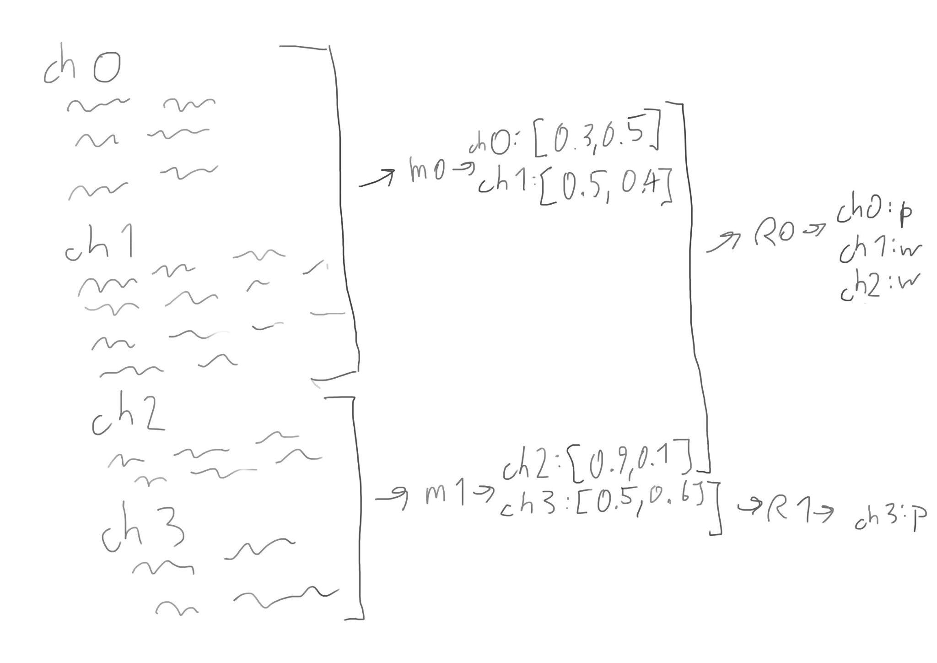
map
reduce
“Map”
“Shuffle”
“Reduce”

